Slide 1

Do winter cover crops suppress weeds in Midwestern corn- and soybean-based systems? A meta-analysis
Andrea Basche¹, David Weisberger², Virginia Nichols², Alisha Bower³, Chris Wilbeck³, Sarah Carlson³
1. University of Nebraska-Lincoln, Department of Agronomy and Horticulture, Lincoln, NE
2. Iowa State University, Department of Agronomy, Ames, IA
3. Practical Farmers of Iowa, Ames, IA

Slide 2
Project background and rationale
Focusing on the Corn Belt
Large production
Predominance of annual cropland
Climate and predominant cropping systems limit heat units for CCs
And potential for cost savings associated with input reductions
Question: What is the potential for cover crops to reduce weeds and offset herbicide costs, based on previously published studies?
Recent review article (Osipitan et al. 2018 Agronomy Journal) addresses some of this question but was not specific to Corn Belt
Notes:
Midwestern Corn Belt is different than edges of it in SE or MidAtlantic states – we grow corn and beans (will look more at NASS data to see what % of the states are growing c/s).
Fall planted only: window for cc’s that is most likely to advance
We think this is a super important question for our region / environment – major reason is the limited heat units – so what can cover crops do based on what the data says – the only way to make it pay is to offset herbicide costs – hypothesize that we can cut costs.
Recent paper came out - explain
This is a call to action for us as researchers- farmers are seeing this anecdotally but is this what we are seeing in the research?

Slide 3
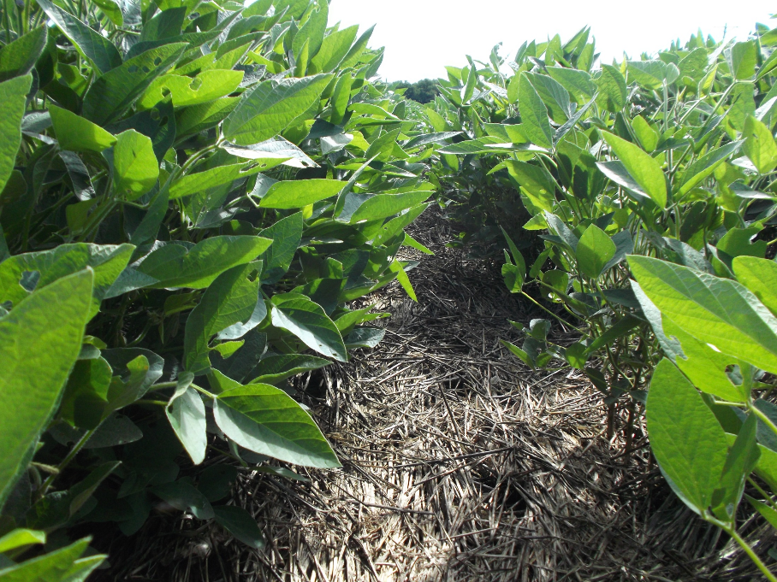
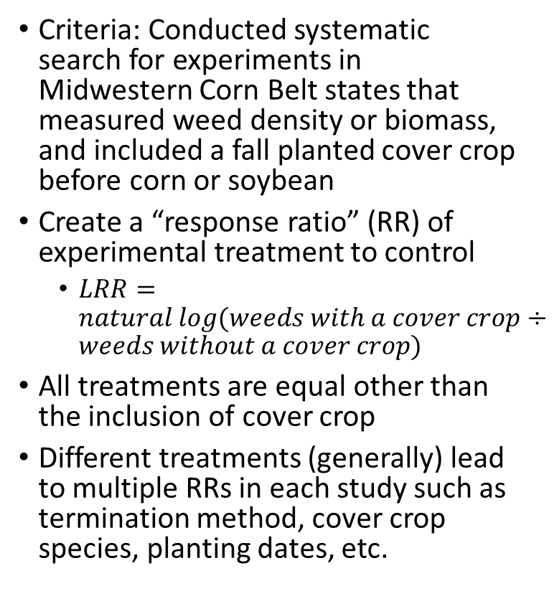
Analysis
Criteria: Conducted systematic search for experiments in Midwestern Corn Belt states that measured weed density or biomass, and included a fall planted cover crop before corn or soybean
Create a “response ratio” (RR) of experimental treatment to control
$LRR=natural log(weeds with a cover crop÷weeds without a cover crop)$
All treatments are equal other than the inclusion of cover crop
Different treatments (generally) lead to multiple RRs in each study such as termination method, cover crop species, planting dates, etc.
Notes:
Searched WOS for studies in the CB – fall planted CC, before corn or soy
Create a ratio – key unit we’re investigating in analysis like this – really the equalizer
Equation is the weeds w/ cc divided by no cc – and that would be the ONLY difference in all of our studies – control is no cover crop
Most studies looked at a few diff trts which leads to more RRs

Slide 4
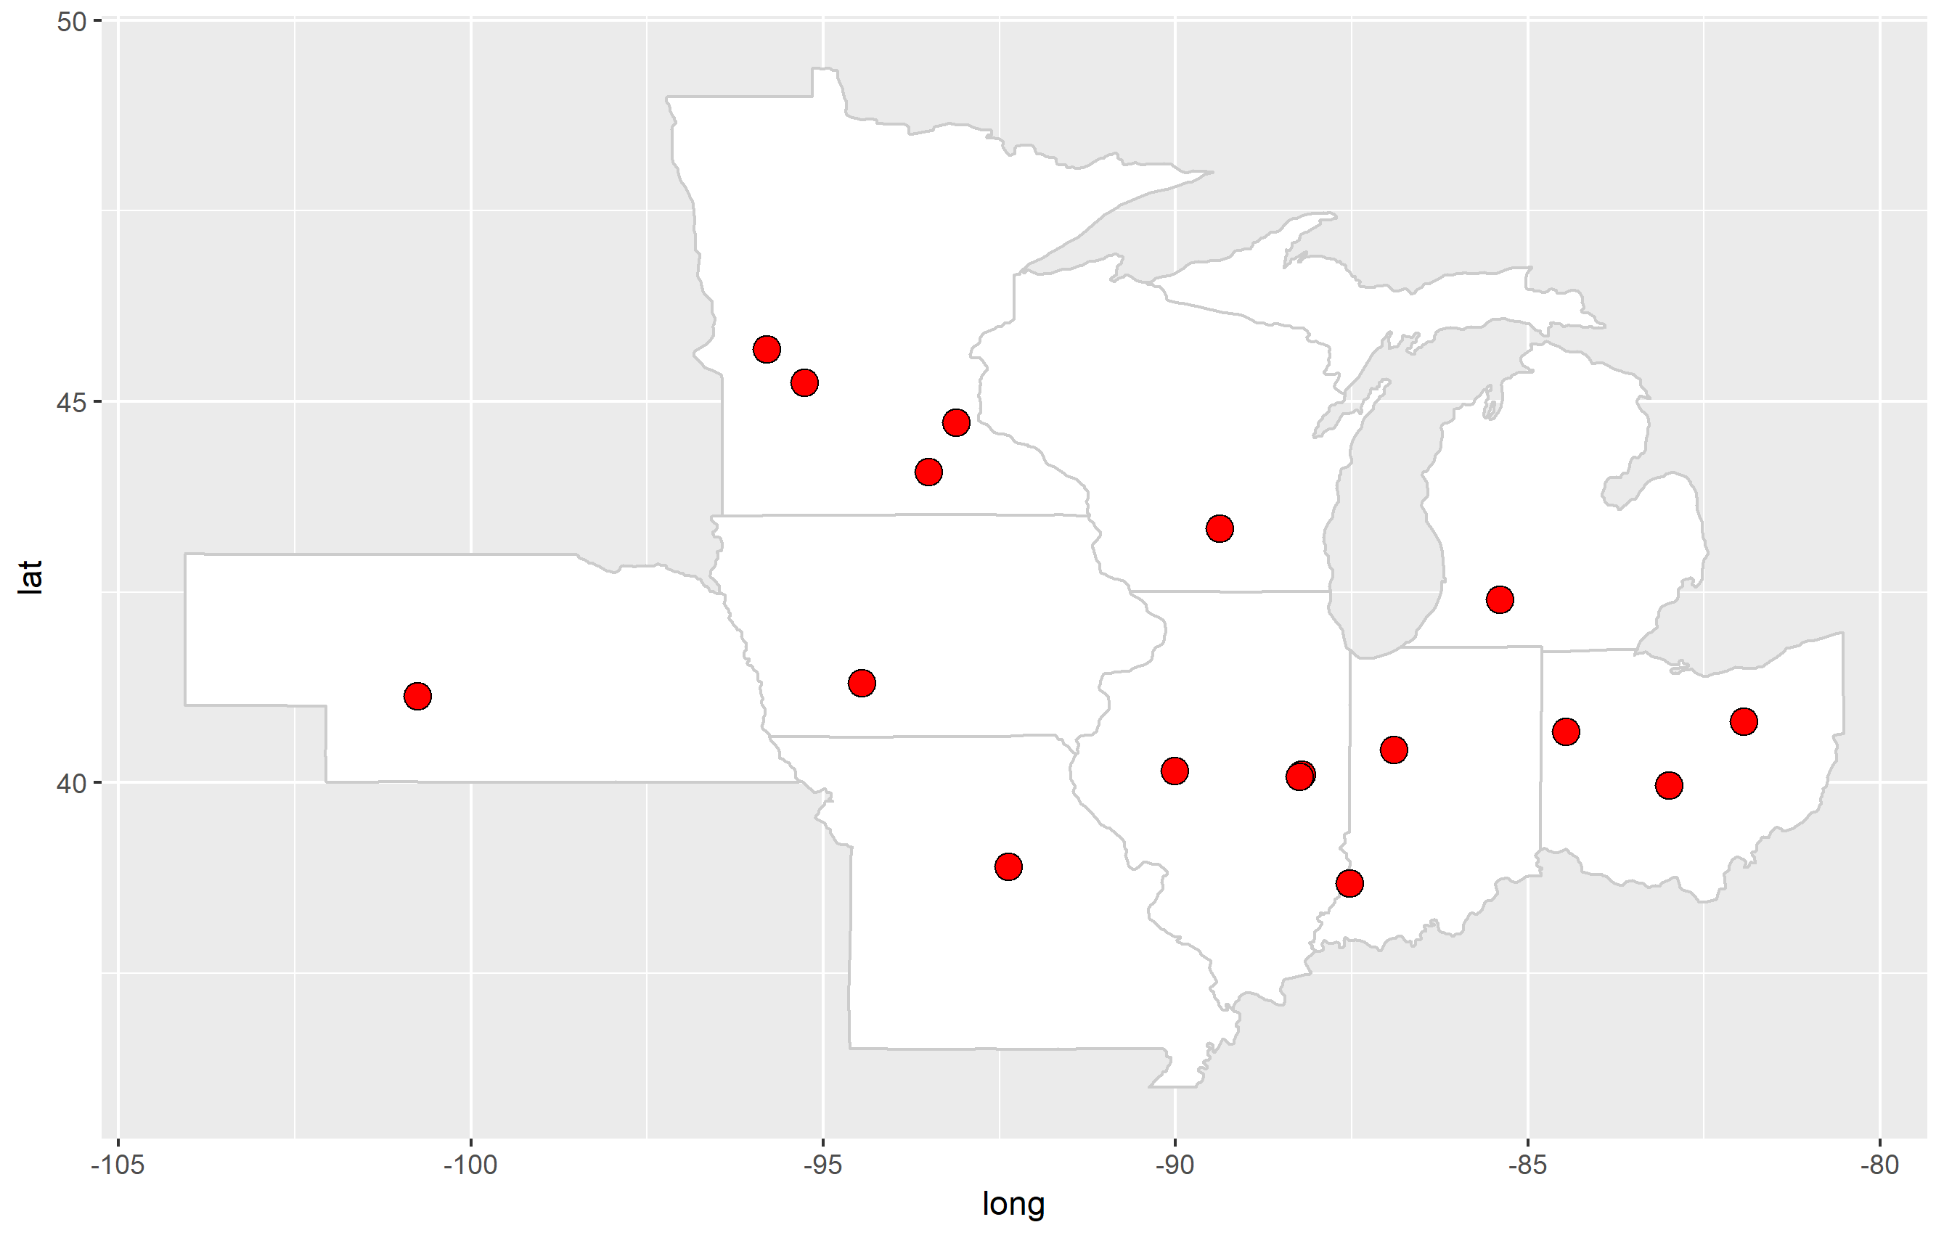
Screened 665 potential experiments and have included 15 in a database for this preliminary analysis
*Illinois, Indiana, Iowa, Kansas, Michigan, Minnesota, Missouri, Nebraska, North Dakota, Ohio, South Dakota, and Wisconsin
Notes:
Have a few candidate studies for KS, have not found any in the Dakotas

Slide 5

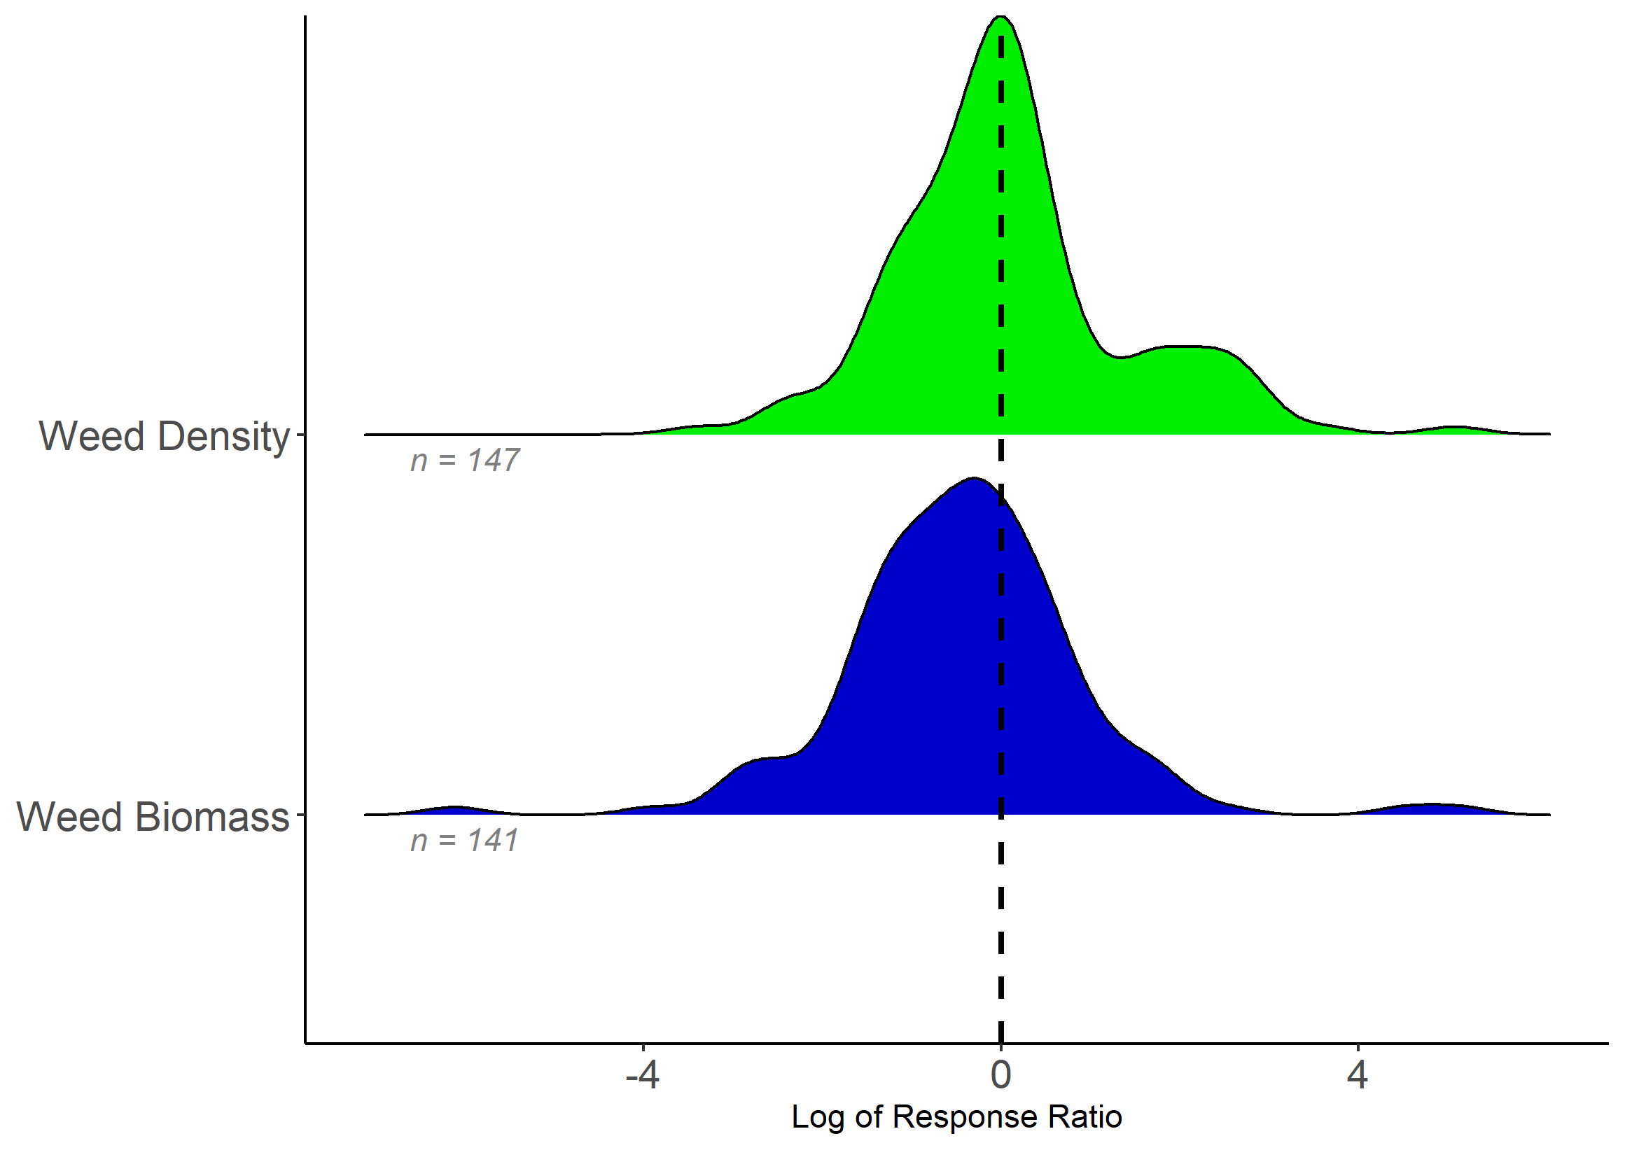
$$Log response ratio=natural log(weeds w/ cover crop÷weeds w/out cover crop)$$
Decrease in weeds
Increase in weeds
48% of RRs decrease weeds
64% of RRs decrease weeds
Notes:
Let me describe what you’re looking at here
This is the overall distribution of response ratios – again the ratio is the weeds measured – either biomass or density – in the cover crop trt divided by no cover crop treatment
So (animate arrows) if the weeds in cc were in the numerator and they were lower than we would have a RR below zero. If weeds in the cc trt were greater than there would be a value above zero
Overall what we found is that in 48% of RRs there was a decrease in weed density w/ cc
And in 64% of the RRs there was decrease in weed biomass w/ cc
So what does that mean? It means that the glass is either half full or half empty – what can *we* learn from this about when the glass was more empty, so that we can more consistently have it be full?

Slide 6
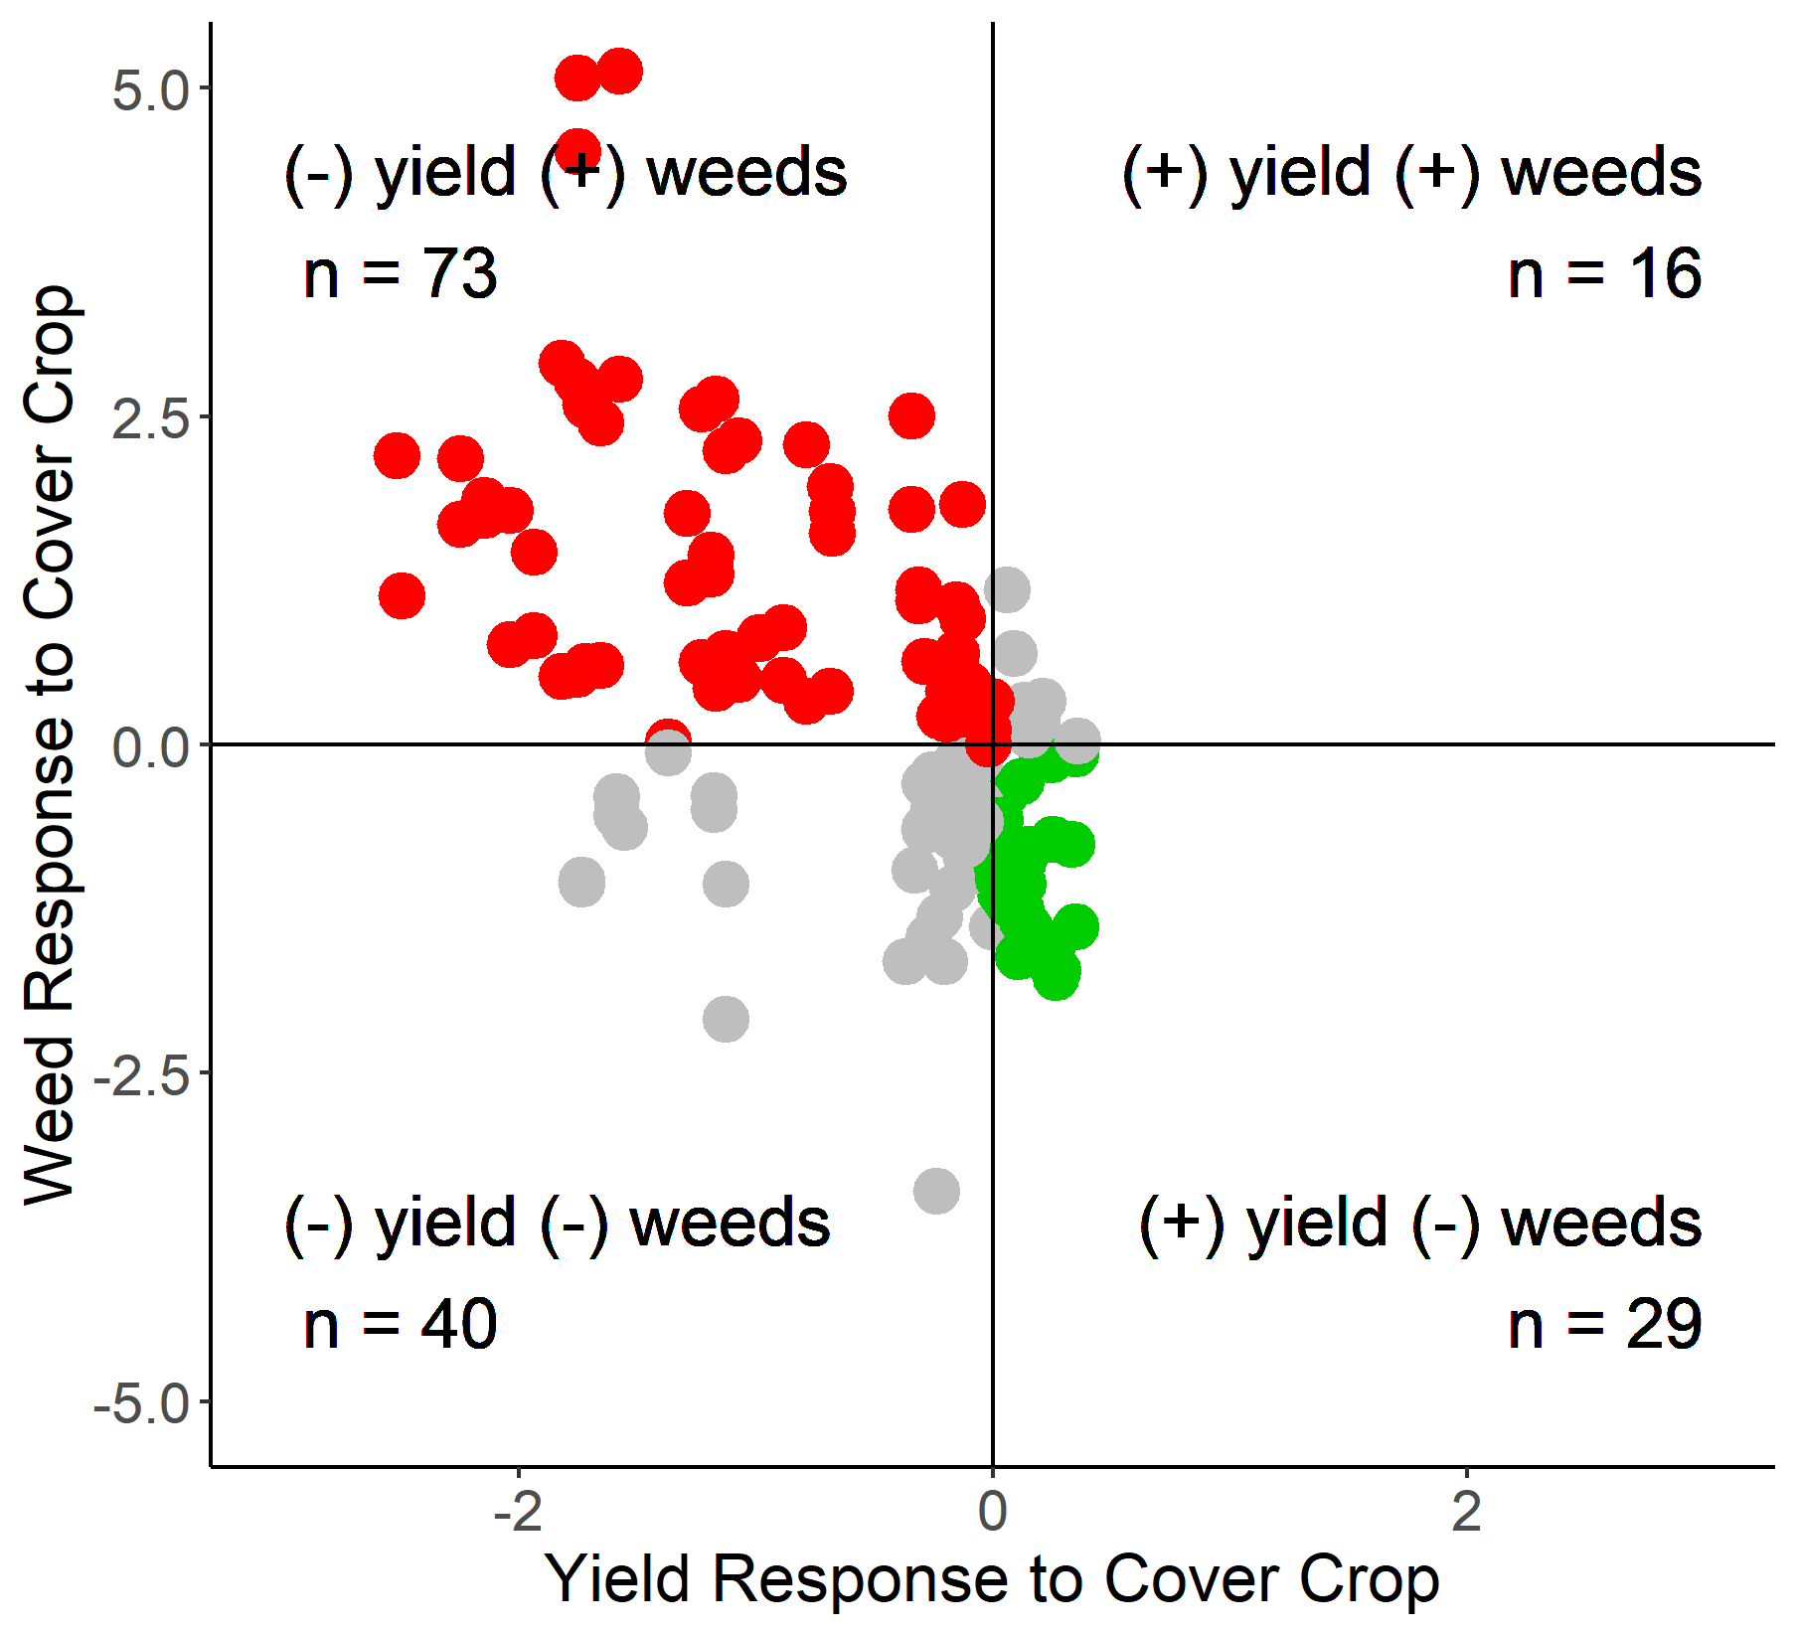
Lose Lose
46%
Increase weeds
Win Win
18%
Decrease weeds
Decrease yield
Increase yield
Notes:
Let me just add a little more complexity to the story before I run out of time
Some of the expts reported yields. And we looked similarly at crop yields as a ratio – so that’s what you’re looking at here on the x axis, so (animate arrows) if there is a value above 1 that means the cc increased yields, and if there is a value below they decreased yields
And we’ve plotted the weed response (both den and bio) on the y axis
This is a neat little trick because it allows us to look at the best case scenario – where cc decreased weeds and increased yields – which was 18% of the RRs
AND also, where cc increased weeds and decreased yields, so the least favorable outcome, and that was 46% of the RRs
So what can we learn from this so that more fall into the lower quadrant…. ?

Slide 7
Summary
More work is needed to increase the efficacy of cover crops to control weeds
Poster explores more of the management questions
What is in the win-win category? More cc before soybean than corn
What is in the lose-lose? More when the cc was mowed or crimped
Biomass is important but likely not the only important consideration
Visit Poster 1137 to learn more and share ideas from 4-6pm this afternoon
Notes:
Quickly to wrap up: Its clear from the published literature that we haven’t figured out how cover crops can reduce weeds to offset costs in the MW systems
Learn more at the poster – noted a few things we’ve noticed that the poster has more detail on
Extra notes:
How would density plot look diff if separated by crop – if its just soybean then it could be explained by heat units
Could be about germination timing of weeds
Are pre emergence / or post emergence residual herbicides less effective? Were weed increases a result of a particular herbicide system.
Farmers also say that see increased weeds.
Maybe a more favorable seed bed for weeds
Tillage could explain more weeds – turning over more seed weeds / increase weed germination – note that none of our studies used tillage to terminate the cover crop
Mowing could also be responsible for a more favorable seed bed – maybe DeBruin mowed too early

